Slide 1


Exploring Electroacoustic Music Analysis with Multimodal Large Language Models
Dr. Egor Polyakov
Jahrestagung der Gesellschaft für Musikforschung
Kollaborationen ∞ Wider den Methodenzwang
11. - 14. September 2024

Slide 2
Personal Background (in AI/ML)
Composer/Performer Background
Strong foundation in algorithmic composition
Expertise in Max, Audiosculpt and OpenMusic
Focus on generative algorithms
CAMAT Project (2021-22)
Python-based toolbox for symbolic music analysis
Conducted at HfM Weimar under the leadership of Martin Pfleiderer
Researchers: Egor Polyakov and Christon-Ragavan Nadar (Semantic Music Technologies Group at Fraunhofer-Institut für Digitale Medientechnologie)
AI was not a core component of the project, but interaction with Christon-Ragavan Nadar introduced me to machine learning topics, such as audio classification and dimensionality reduction
Shift in Research Focus towards machine learning applications in music
ML-assisted audio synthesis
Audio and symbolic music generation

Slide 3
Analyzing Music with Large Language Models (LLMs)
Encounter with LLMs in Audio Analysis
In early 2024, while preparing a talk on ML-based audio classification, I came across a series of papers by Gong et al.
Audio classification is a well-established task with a long research history and many standardized benchmarks
The papers by Gong et al. presented an intriguing approach that goes beyond traditional classification or feature extraction
Innovative Approach by Gong et al.
Utilizes a Large Language Model (LLM) to describe audio content, rather than just classifying it
Enables reasoning and detailed questioning about what is happening within the analyzed audio file
Offers a new dimension to understanding and interpreting audio data
Implications for Music Analysis
Let's explore the mechanics of how this approach works
Consider whether this new method could be beneficial for music analysis

Slide 4
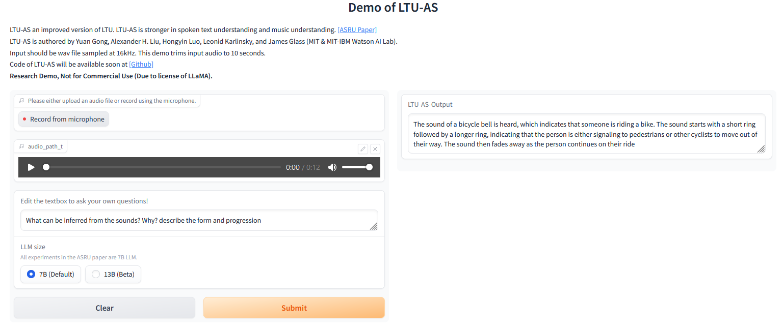
https://huggingface.co/spaces/yuangongfdu/ltu-2

Slide 5

Examples
The audio clip contains a series of short, sharp, and repetitive sounds that are likely produced by a mechanical device. The sounds have a consistent pattern and rhythm, suggesting they may be part of a larger system or process. They also appear to be relatively loud and intense, which could indicate that the machine is operating at full capacity or under heavy load.
The audio clip contains a sound effect that is being created using a synthesizer. The sound starts with a low-pitched drone, followed by a series of rising and falling notes that create a melody. The sound gradually builds up in intensity before fading away.
The sound of a bicycle bell is heard, which indicates that someone is riding a bike. The sound starts with a short ring followed by a longer ring, indicating that the person is either signaling to pedestrians or other cyclists to move out of their way. The sound then fades away as the person continues on their ride.
François Bayle - l'Aventure du cri (1969) 2:10 - 2:20
François Bayle - l'Aventure du cri (1969) 0:22 - 0:32
Bernard Parmegiani - De Natura Sonorum - incidences / battements (1975) 0:00 – 0:10

Slide 6
Spectromorphology?
Introduced in 1997 by Dennis Smalley as an analytical theoretical framework for electroacoustic music
Used to describe and interpret the ways in which sounds are shaped and interact within a musical context
Particularly useful for analyzing complex, non-traditional musical forms, such as acousmatic and electroacoustic compositions, where traditional music theory may not fully apply
Relies on a specialized vocabulary to describe the characteristics and behaviors of sound
Focuses on the perceptual aspects of how sound evolves and interacts within a piece of music
Key categories of descriptive terms in spectromorphology
Spectral Terms
Morphological Terms
Behavioral Terms
Source-Cause Terms
What are the capabilities of systems similar to LTU-AS in a spectromorphological context?

Slide 7
Spectral Terms:
Brightness/Darkness: Referring to the high or low frequency content of a sound.
Density: The concentration of frequencies within the spectrum.
Texture: The layering or blending of different spectral elements.
Morphological Terms:
Attack: The onset of a sound, which can be sharp, soft, gradual, etc.
Decay: The fading or termination of a sound.
Growth: The development or increase in a sound’s intensity or complexity over time.
Gesture: The dynamic movement of sound, often perceived as having a physical or directional component.
Behavioral Terms:
Motion: The perceived movement of sound in space or its evolution over time.
Flow: How smoothly or abruptly a sound transitions or changes.
Grain: The perceived texture or granularity of a sound.
Source-Cause Terms:
Mimesis: The imitation of real-world sounds.
Immateriality: Describing sounds that do not suggest a clear physical source.

Slide 8
What are multimodal LLMs?
„Classic“ LLMs are token predictors
Token = flexible unit that can represent a subword, a word, or even a character
Common words like "the" or "is" might be a single token, less common or compound words might be broken down into multiple tokens (e.g., "unhappiness" might be tokenized as "un", "happi", and "ness")
When I hear rain on my roof, I _______ in my kitchen.
Probability Token(s)
9.4% cook soup
5.2% warm up a kettle
3.6% cower
2.5% nap
2.2% relax

Slide 9
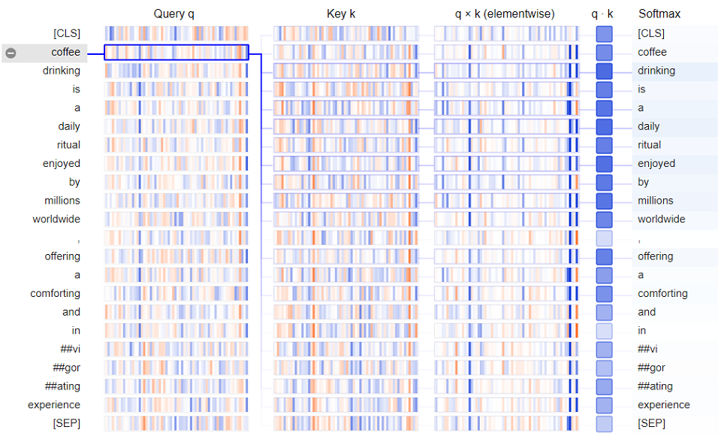
"How much does each other token of input affect the interpretation of this token?“
=> Self-Attention

Slide 10
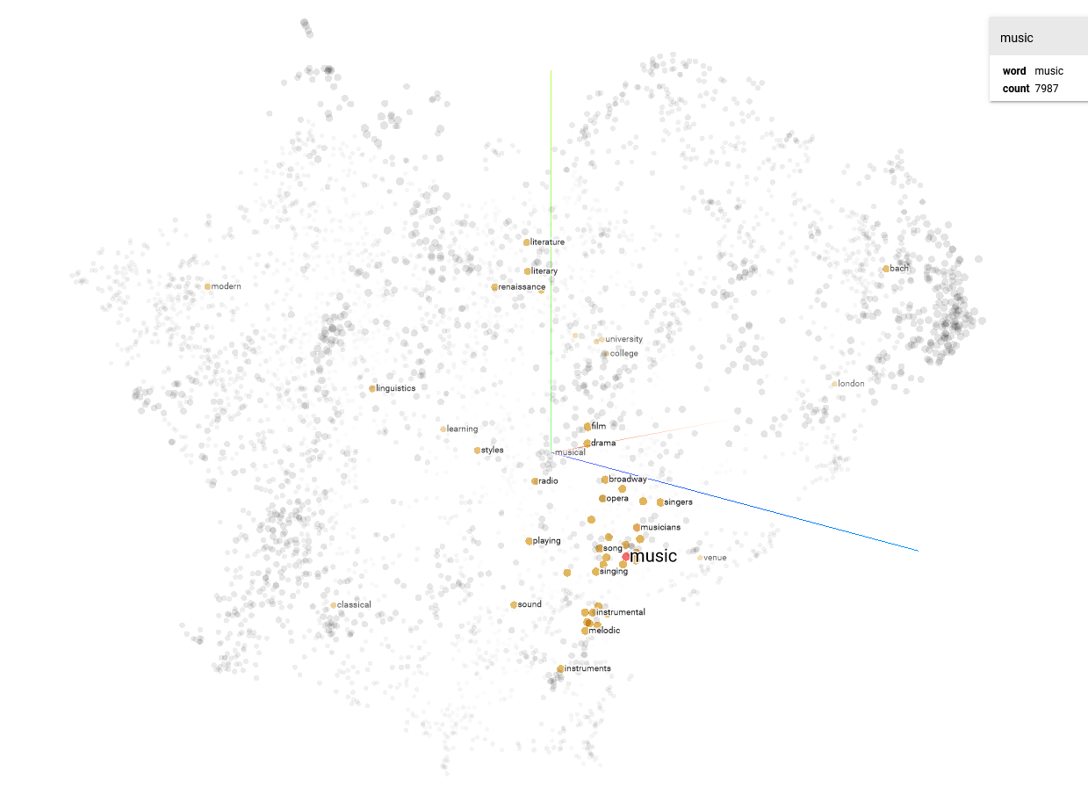
https://projector.tensorflow.org/

Slide 11
https://cohenori.medium.com/llm-token-economy-optimization-d1c3feea880b

Slide 12
https://geoffrey-geofe.medium.com/

Slide 13
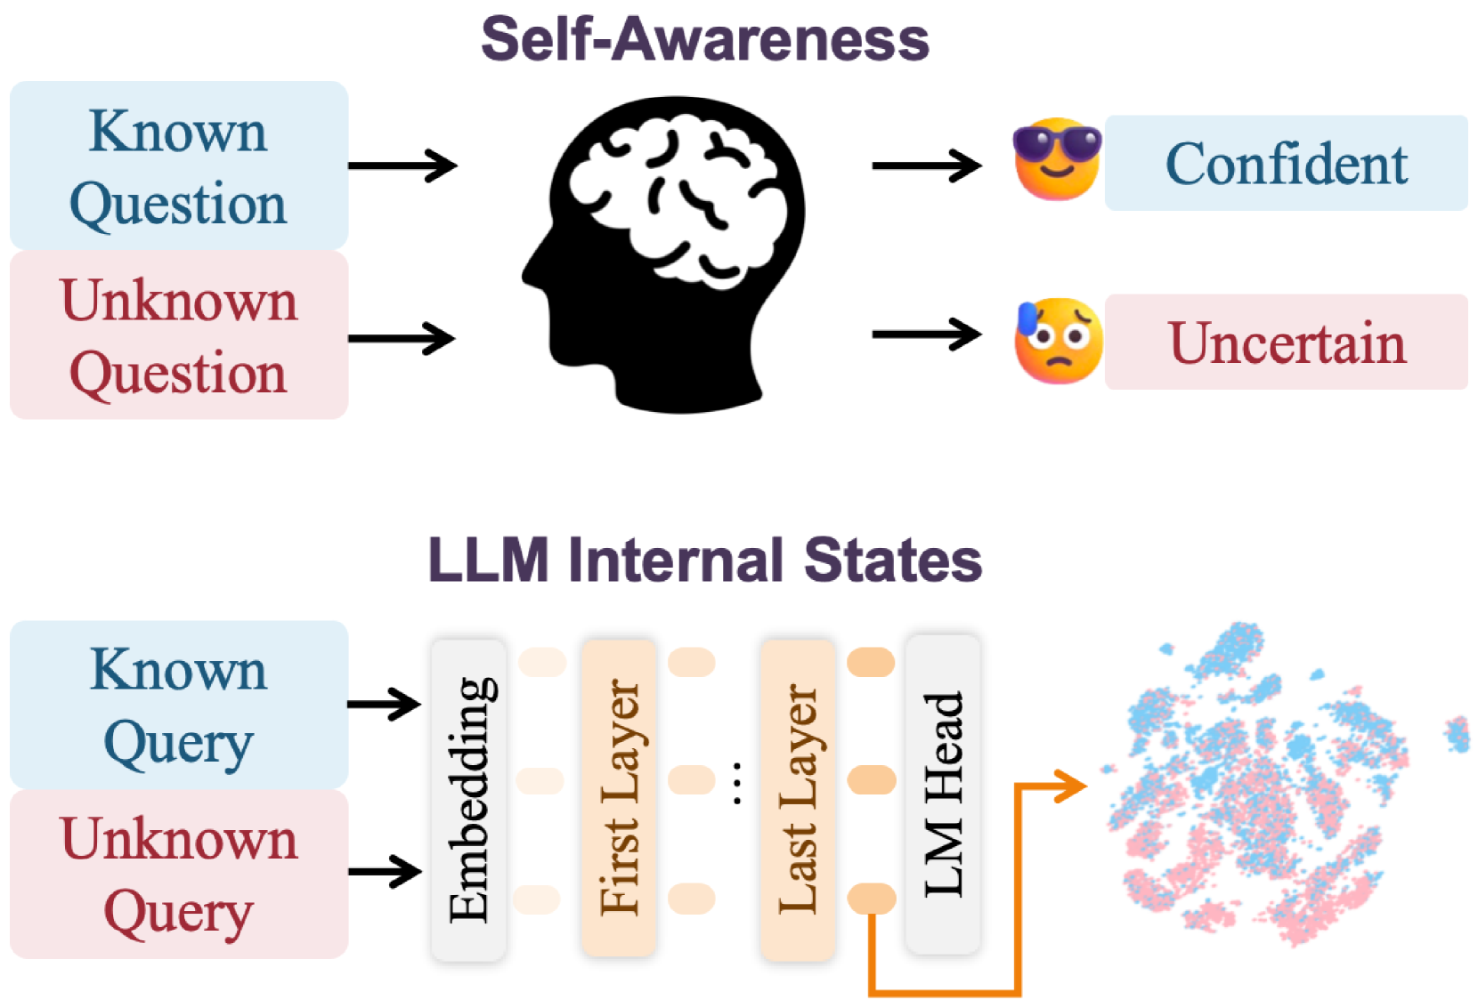
Hallucinations
Phenomenon in which an LLM generates information or responses that are factually incorrect, nonsensical, or fabricated but may sound plausible and coherent
JI et al. 2024: https://arxiv.org/abs/2407.03282v1

Slide 14
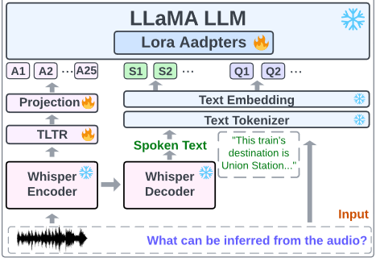
LTU-AS Structure, Gong et al. 2023: https://arxiv.org/pdf/2309.14405

Slide 15
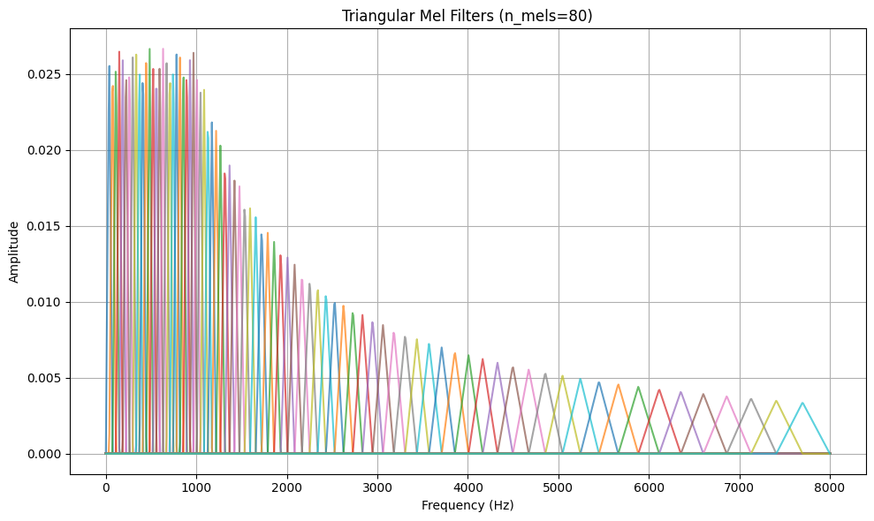
What happens with audio within Encoder?
HUGE quality loss
Examples in whisper_reconstruct.ipynb notebook
All audio is re-sampled to 16,000 Hz, and an 80-channel log-magnitude Mel spectrogram representation is computed on 25-millisecond windows with a stride of 10 milliseconds.

Slide 16
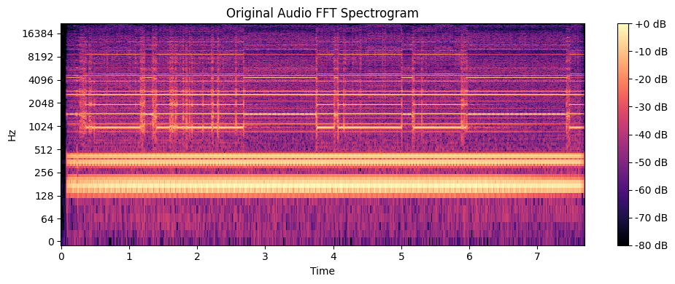
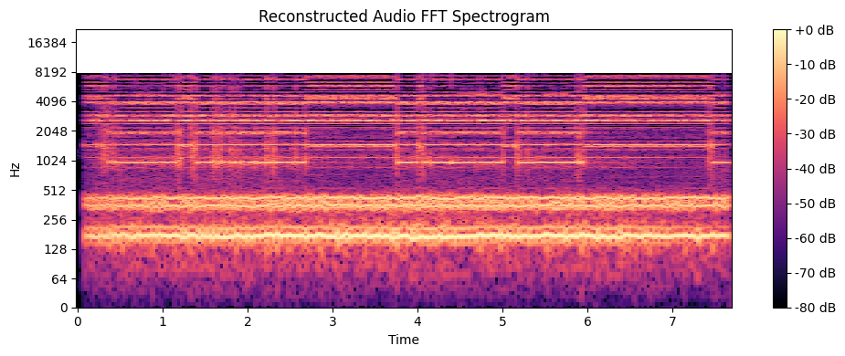

Slide 17
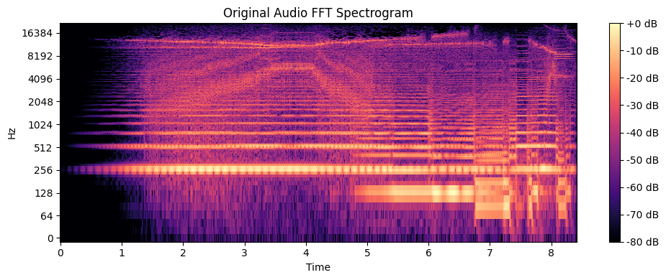
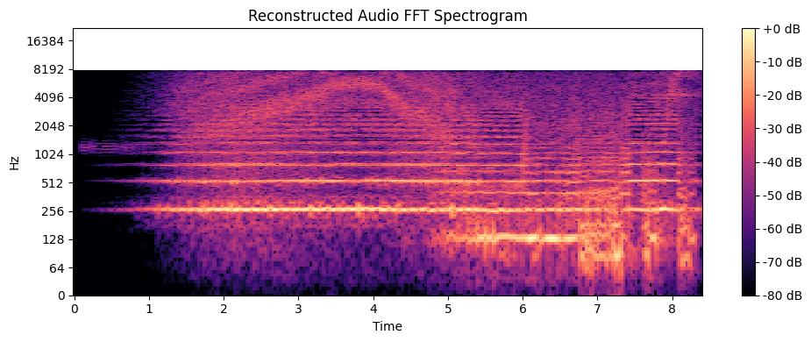

Slide 18
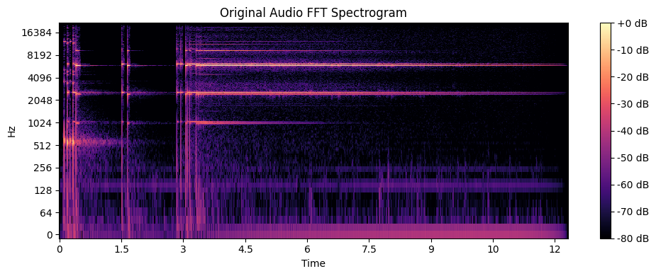
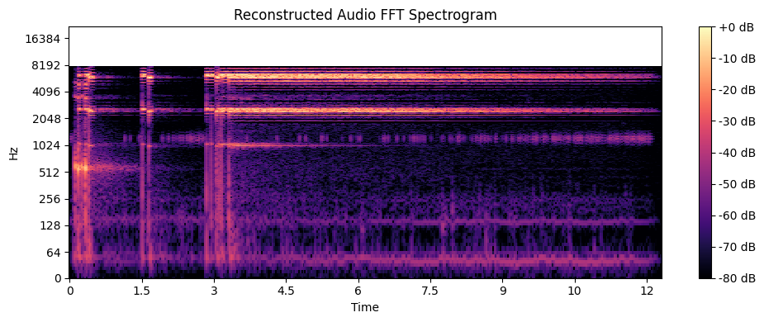

Slide 19
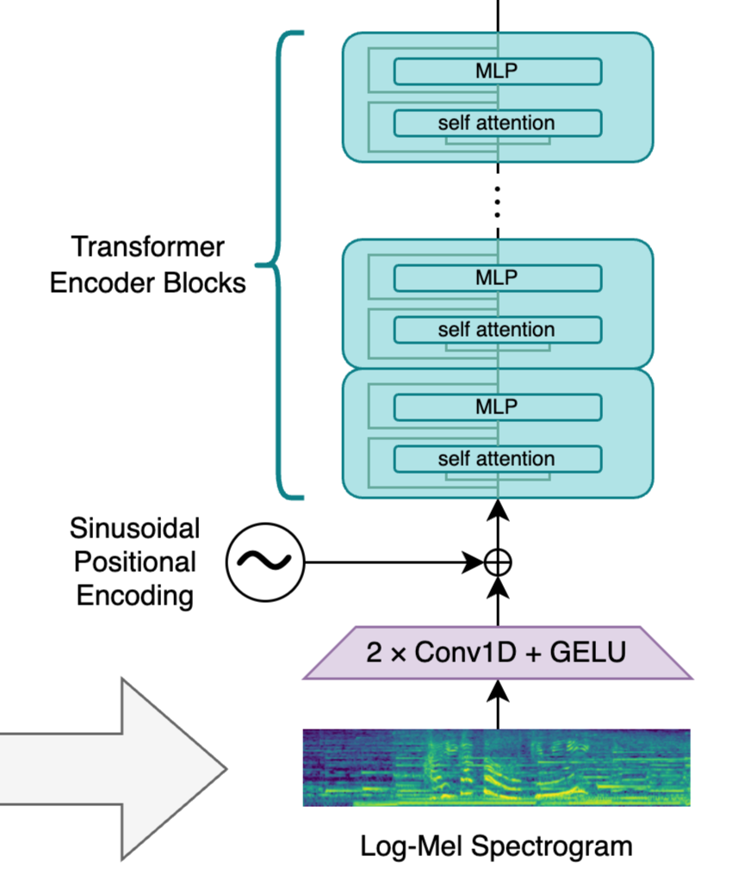
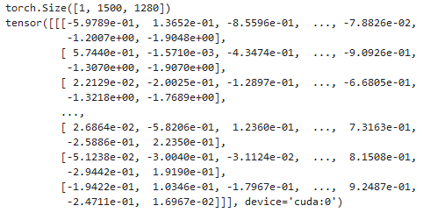
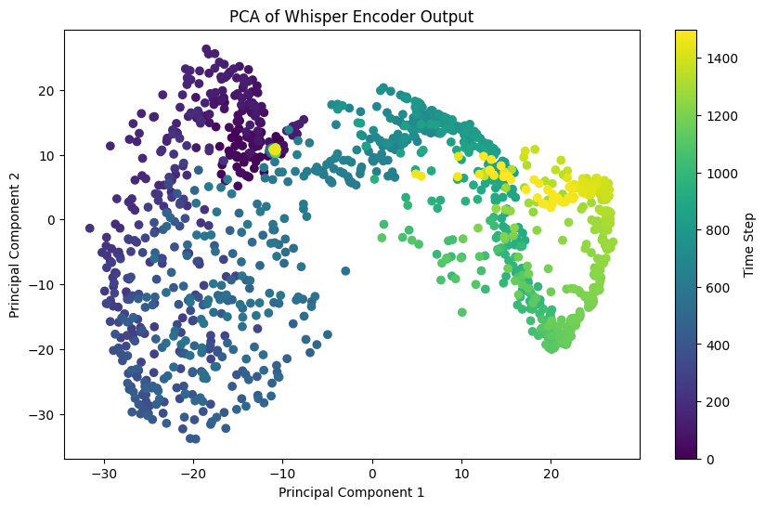
OpenAI Whisper encoder dataflow

Slide 20
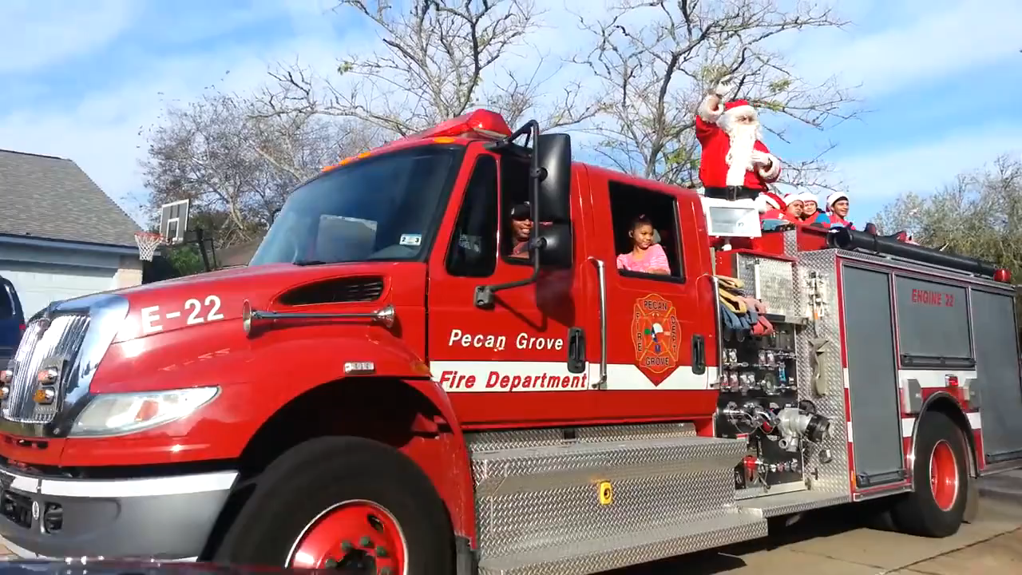
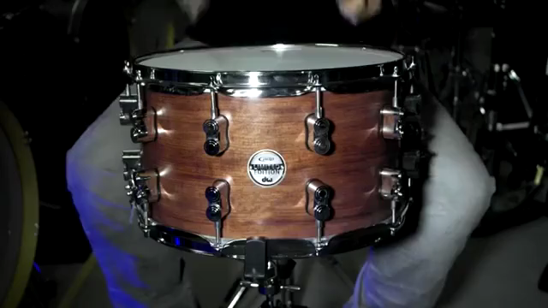
Datasets (over 1m examples total)
“A child shouts, and an adult male speaks, while an emergency vehicle siren sounds with the horn blowing”
https://research.google.com/audioset/index.html
„playing snare drum“

Slide 21
AQA LLM Training
Synthetic Dataset Creation
ChatGPT uses reasoning ("hallucinates„) to generate hypothetical scenarios where specific audio cues might be present
The model leverages both reasoning and creativity to infer what could happen in a particular audio environment
Sources for Data Generation
Audio descriptions from an existing dataset provide a foundational reference for the hallucinated scenarios
Whisper decoder output is used to extract detailed information from the audio, offering a more refined input for generating plausible descriptions
Training Objective
The goal is to create a synthetic dataset that can train large language models (LLMs) to analyze and describe audio in a way that integrates reasoning and contextual awareness, going beyond basic feature extraction or classification
By simulating hypothetical settings with relevant audio cues, this approach aims to enhance the LLM’s ability to understand and interpret complex audio scenes

Slide 22
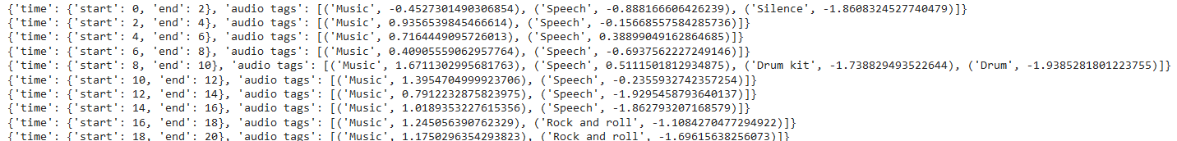
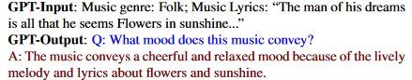
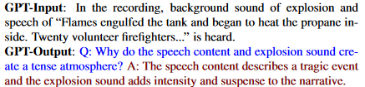
Whisper-AT audio tagging output
AQA pairings from LTU-AS dataset

Slide 23
What exactly are we getting as the output?
Heavily distorted audio used as an analysis source (max. 10 sec)
Embedding space fine-tuned for audio classification based on annotated YouTube videos
Embedding space fine-tuned using ChatGPT-generated hypothetical scenarios where specific audio cues might be present

Slide 24
Another options?
CLAP (Elizalde et al., 2022)
Currently (one of the) best performing audio classifiers (98% on ESC-50)
Features higher signal bandwidth in the encoder compared to Whisper
Maximum sample length of 5 seconds
LLark (Gardner et al., 2024)
Promising new model from Spotify, designed specifically for music understanding
Capable of analyzing audio segments up to 25 seconds in length
Analysis Approach: Waveform-based, based on OpenAI's Jukebox, with a resolution of 44.1 kHz
Common Limitations
Neither model has online accessible inference
Requires server-grade hardware and a lot of python experience to run

Slide 25
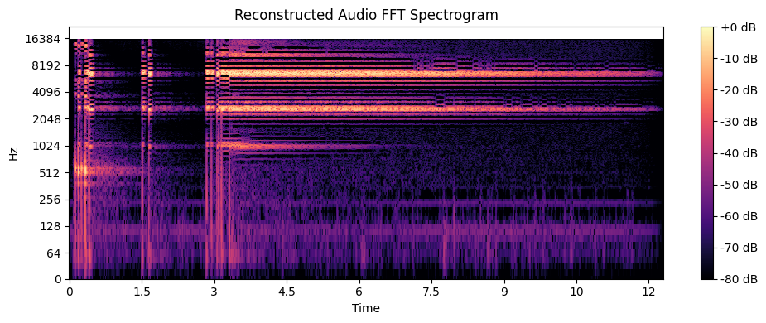
CLAP audio encoder

Slide 26
Evaluation of multimodal LLMs for analysis?
Spectral Terms:
Brightness/Darkness: Referring to the high or low frequency content of a sound
=> possible, but restricted by bandwidth
Density: The concentration of frequencies within the spectrum
=> possible, but restricted by bandwidth
Texture: The layering or blending of different spectral elements
=> possible (even favorable, esp. if elements can be easily classified as separate audio objects), but restricted by bandwidth, time resolution and context window (5-10 seconds are not enough)
Morphological Terms:
Attack: The onset of a sound, which can be sharp, soft, gradual, etc.
=> possible, but restricted by bandwidth and time resolution
Decay: The fading or termination of a sound
=> possible, but restricted by bandwidth and time resolution
Growth: The development or increase in a sound’s intensity or complexity over time
=> possible, but restricted by bandwidth and time resolution
Gesture: The dynamic movement of sound, often perceived as having a physical or directional component
=> Possible (even favorable, esp. if elements can be easily classified as separate audio objects), but restricted by bandwidth, time resolution and spatial understanding (most current models are monophonic by design)

Slide 27
Behavioral Terms:
Motion: The perceived movement of sound in space or its evolution over time
=> possible, but restricted by bandwidth, time resolution and spatial awareness
Flow: How smoothly or abruptly a sound transitions or changes
=> possible, but restricted by bandwidth and time resolution
Grain: The perceived texture or granularity of a sound
=> missing training data, also restricted by bandwidth and time resolution
Source-Cause Terms:
Mimesis: The imitation of real-world sounds
=> can work exceptionally well with current models
Immateriality: Describing sounds that do not suggest a clear physical source
=> can work exceptionally well with current models

Slide 28
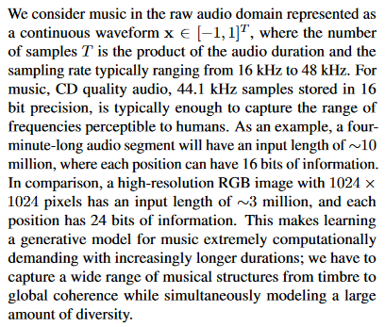
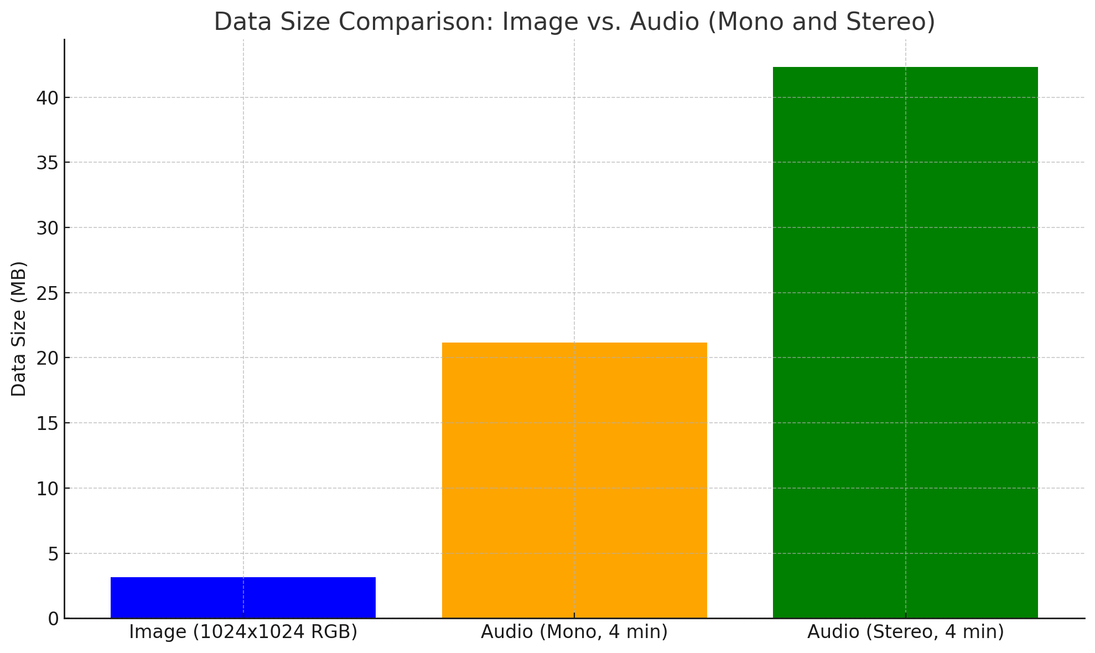
Problems
High Computational Requirements
Training or fine-tuning large-scale models, like LTU-AS, on audio data requires powerful hardware, often necessitating cloud GPU services, which can be costly
Dhariwal et al. 2020

Slide 29
Technical Expertise
Many of the current state-of-the-art audio models are implemented in Python and require a deep understanding of both Python programming and machine learning libraries like PyTorch or TensorFlow
This high barrier of technical expertise excludes many potential users, particularly in fields like musicology, who may not have sufficient programming experience
Lack of dedicated Datasets for Electroacoustic Music Analysis
There is a lack of dedicated datasets for genres like electroacoustic music, which has its own unique sonic characteristics
Existing general-purpose datasets may not capture the full range of sounds in electroacoustic compositions, leading to suboptimal performance in genre-specific tasks
Copyright Issues with Original Recordings
All essential works in electroacoustic music are still under copyright protection, raising challenges for using original recordings in research or model training
The limited access to such recordings hampers the creation of large, high-quality datasets for this genre
Suboptimal Audio Features (MFCC):
Many current models still rely on Mel Frequency Cepstral Coefficients (MFCC), a low-bandwidth encoding often used in speech recognition, but suboptimal for capturing the full richness of musical timbre, especially in electroacoustic music

Slide 30
Solutions?
Streamlined Research in Humanities:
Multimodal LLM research requires a capable local CUDA setup or funds for cloud services. Both training and inference incur significant costs:
LTU-AS training/fine-tuning costs several thousand dollars on cloud computing, based on current server prices.
Inference costs: $25–50 per day for smaller models; hundreds per day for larger models.
Without accessible research funding, especially in humanities, LLM integration/refinement becomes inefficient.
Training smaller/downscaled models on platforms like Paperspace Gradient offers affordable options ($8–39 GPU flat-rate subscriptions), but takes significantly more time due to restrictions and limited resources.
Dedicated Datasets:
Creating datasets for electroacoustic music is constrained by copyright issues.
Use synthetic datasets to capture basic timbre, motion, and spatial features (leveraging available plugins).
Collaborate with composers willing to provide works for AI training, ensuring clear legal agreements to avoid potential disputes.

Slide 31

Thank you!
egor.polyakov@hmt-Leipzig.de
https://egorpol.github.io/
https://github.com/egorpol/Electroacoustic-LLM-Analysis

